Slide 1


CONTENTS
01
Introduction
02
Dataset Overview
AI Based Face Mask Detection System
03
Model Architecture
04
Training Process
05
Results and Evaluation
06
Deployment

Slide 2
01
INTRODUCTION
The Role of AI in Solving Real-World Problems
AI and Machine Learning (ML) are transforming industries by solving complex real-world problems.
One such critical area is public health , where AI can enhance safety and compliance with health regulations.
The Importance of Facemask Detection
Face masks act as a barrier, preventing the spread of respiratory droplets that carry viruses and bacteria.
The COVID-19 pandemic highlighted the critical role of masks in public health.
Masks became an essential tool in slowing down the spread of the virus and protecting vulnerable populations.

Slide 3
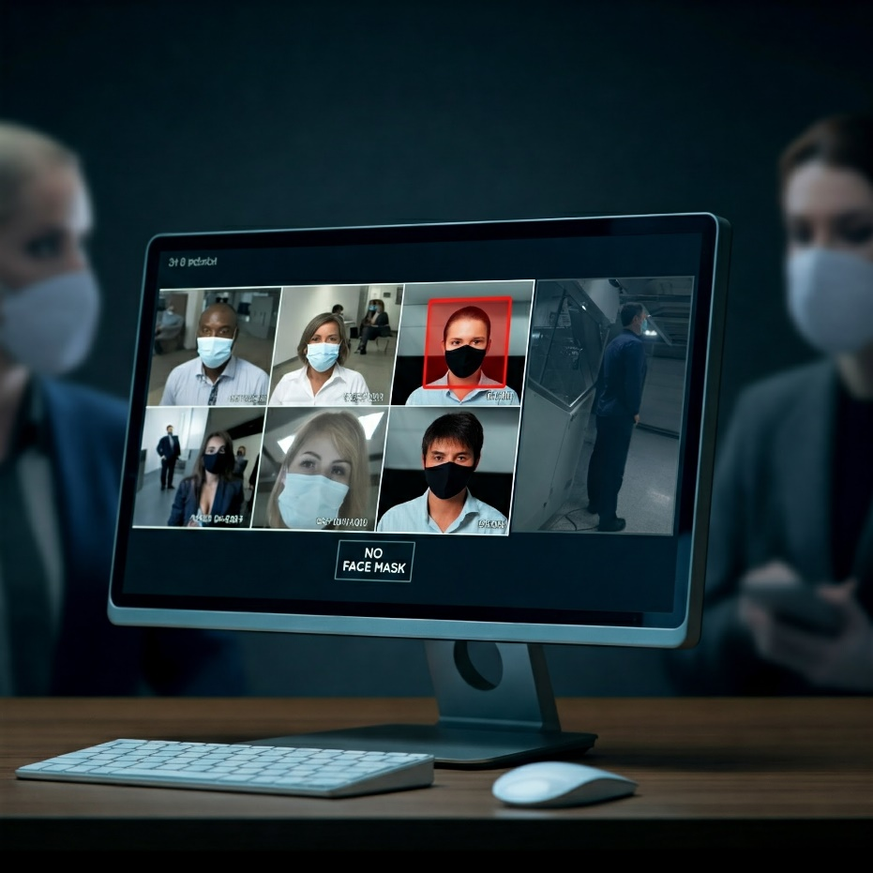
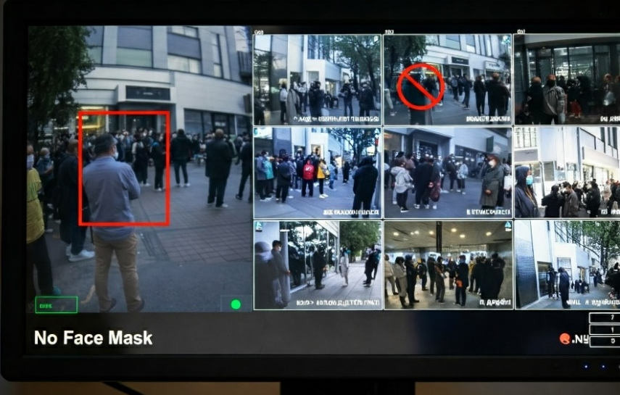
INTRODUCTION
Project Objective
This project aims to develop a facemask detection system that classifies individuals as:
Wearing a mask correctly
Wearing a mask incorrectly
Not wearing a mask at all
Why This Matters
Facemask detection systems can be deployed in various settings to
enhance public safety and ensure compliance with health guidelines, including:
Public spaces (malls, airports)
Healthcare facilities (hospitals, clinics)
Smart surveillance systems

Slide 4
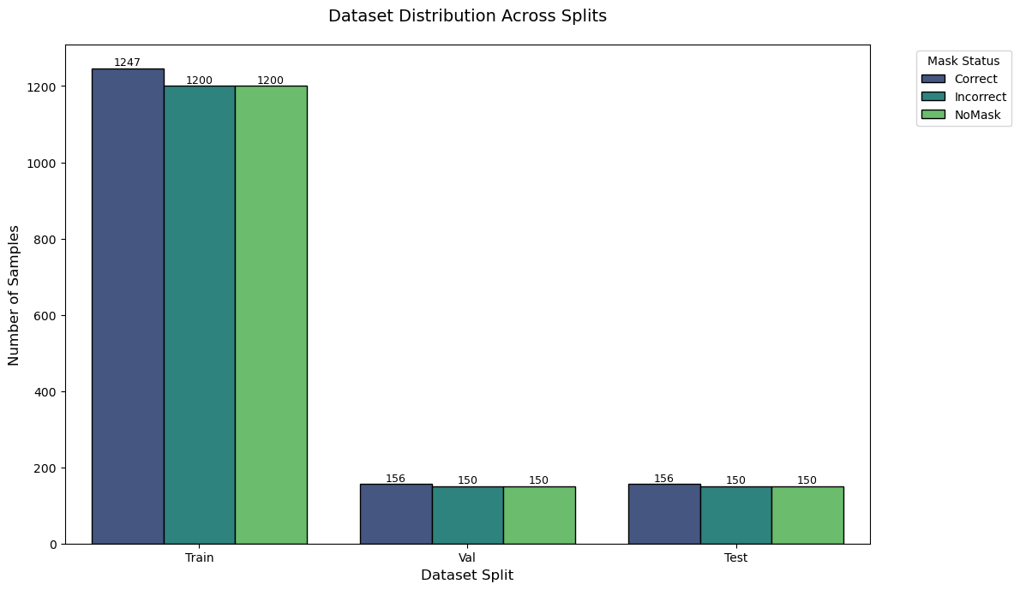
02
Methodology
Data Collection
The first step in building the system is to collect a dataset of images.
This dataset serves as the foundation for training our machine learning model.
The dataset used in this project consists of images of facemasks belonging to 3 different classes:
Correct mask,
Incorrect mask and
No mask
Dataset Details
The dataset contains a total of 4559 images, with
Train set: 3,647
Validation set: 456 and
Test set: 456 images.
Balanced Distribution
The dataset is balanced across classes,
ensuring no bias in model training.

Slide 5
Methodology
Data Preprocessing
Once the dataset is collected,
it needs to be preprocessed before feeding it into the model.
Preprocessing involves
cleaning the data, resizing the images, and organizing them into appropriate directories.
1.Cleaning the data
Removing duplicates,
Incomplete data, and
Images with poor quality.
2.Labeling the data
Identifying and assigning a category to each image
3.Resizing and cropping images
Resize and crop the images to a standard size.
Image are resized to 224x224 pixels or
299x299 pixels for InceptionV3.

Slide 6
Methodology
Model Architecture
Model Selection
The next step is to select a suitable deep learning model architecture for image classification.
When we train the model, we have two options
Custom model architecture or
Transfer learning architecture
We implemented and compared three models:
Custom CNN:
A lightweight model designed specifically for facemask detection.
InceptionV3:
A pre-trained model fine-tuned for transfer learning.
VGG16:
A pre-trained model optimized for image classification.

Slide 7
Methodology
Model Architecture
Custom CNN
Convolutional blocks with Batch Normalization and MaxPooling
Depthwise Separable Convolutions to reduce computational cost
Fully connected Dense layer with Dropout for regularization
Softmax activation for multi-class classification
InceptionV3
Pre-trained on ImageNet
Inception modules with parallel convolutional paths
Fine-tuning the top 20% of layers
Softmax activation for classification
VGG16
Pre-trained on ImageNet
16 layers with small (3x3) convolutional filters
Global Average Pooling, Dense layer, and Dropout for regularization
Softmax activation for classification

Slide 8
Methodology
Training Process
The training pipeline includes:
Data Preparation:
Preprocessing and augmenting the dataset.
Model Compilation:
Defining loss function, optimizer, and evaluation metrics.
Training:
Fitting the model to the training data, validated on the validation set.
Callbacks:
Using EarlyStopping, ModelCheckpoint, and ReduceLROnPlateau.

Slide 9
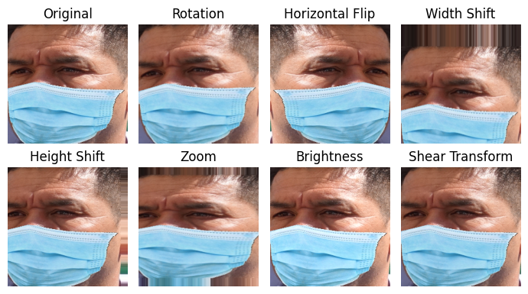
Methodology
Training Process
Data Augmentation
Techniques applied for increased data diversity:
Rotation,
Shifting,
Zooming,
Brightness adjustment,
Horizontal flipping,
Shear transformations.

Slide 10
Results and Evaluation
05
Model Evaluation
After training the model, it is essential to evaluate its performance on unseen data.
Test Set Evaluation:
- Metrics like
Accuracy,
Precision,
Recall, and
Confusion matrix are computed on the test set.

Slide 11
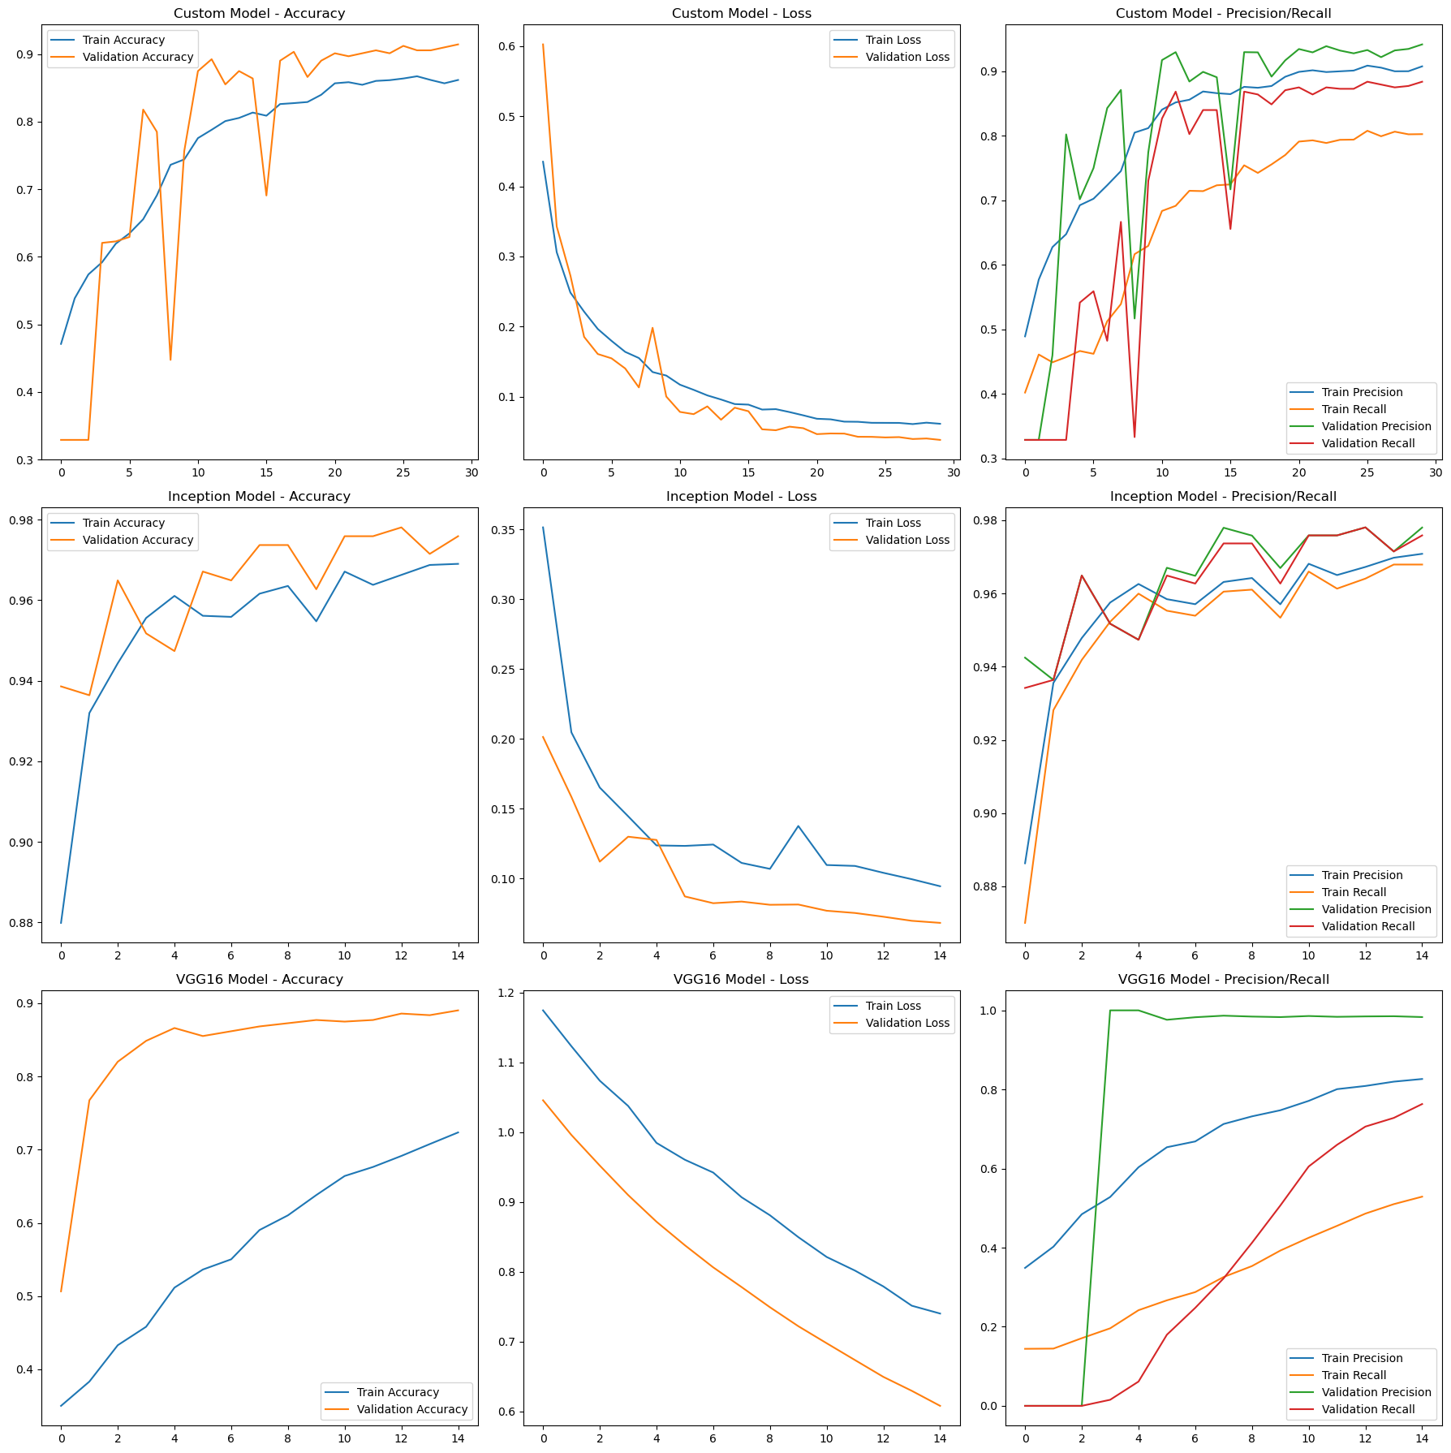
Results and Evaluation
Comparing Different Models
We are compared those three different models based on their accuracy on the test dataset.
The custom model achieved 91.67% accuracy,
When compared to the transfer learning models, its accuracy falls short.
The transfer learning model using the VGG16 architecture achieved 86.40% accuracy.
The transfer learning model using the InceptionV3 architecture demonstrated remarkable Performance with 98.25% accuracy.
Model | Accuracy | Precision | Recall
Custom CNN | 91.67% | 94.85% | 88.82%
InceptionV3 | 98.25% | 98.23% | 97.59%
VGG16 | 86.40% | 97.32% | 71.71%

Slide 12
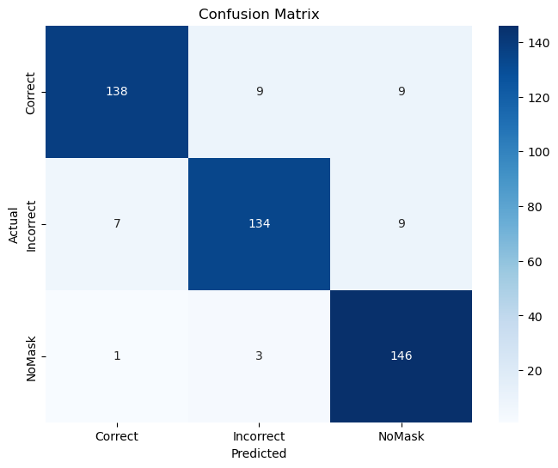
Results and Evaluation
Custom CNN:

Slide 13
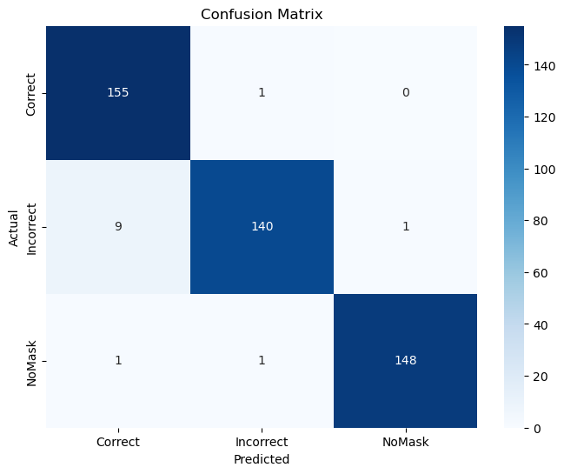
Results and Evaluation
InceptionV3

Slide 14
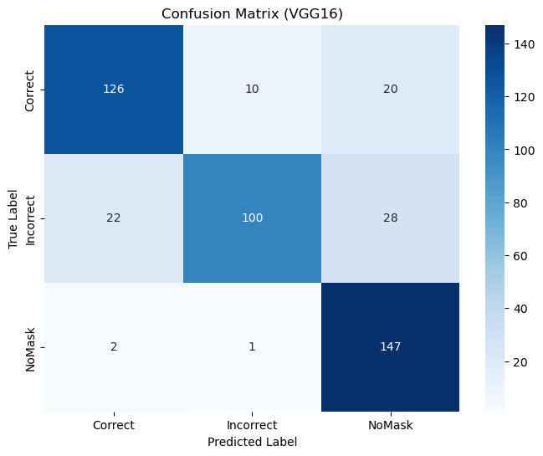
Results and Evaluation
VGG16

Slide 15
Results and Evaluation
(Custom CNN)
(InceptionV6)

Slide 16
Results and Evaluation
Custom CNN:
Class | Precision | Recall | F1-Score
Correct | 0.95 | 0.88 | 0.91
Incorrect | 0.92 | 0.89 | 0.91
NoMask | 0.89 | 0.97 | 0.93
InceptionV3
Class | Precision | Recall | F1-Score
Correct | 0.94 | 0.99 | 0.97
Incorrect | 0.99 | 0.93 | 0.96
NoMask | 0.99 | 0.99 | 0.99
VGG16
Class | Precision | Recall | F1-Score
Correct | 0.84 | 0.81 | 0.82
Incorrect | 0.90 | 0.67 | 0.77
NoMask | 0.75 | 0.98 | 0.85

Slide 17
06
Deployment
01
Saving the trained model as a .h5 file
the model was deployed using Streamlit, an open-source Python library for creating web applications or deploying it on edge devices for real-time face mask detection.
The deployment on streamlit process involved the following steps:
02
Creating a Python script for the web application using Streamlit
03
Loading the saved model into the web application
04
Accepting user input in the form of an image
05
Preprocessing the image in the same way as during training
06
Making a prediction using the trained model
07
Displaying the predicted result to the user

Slide 18
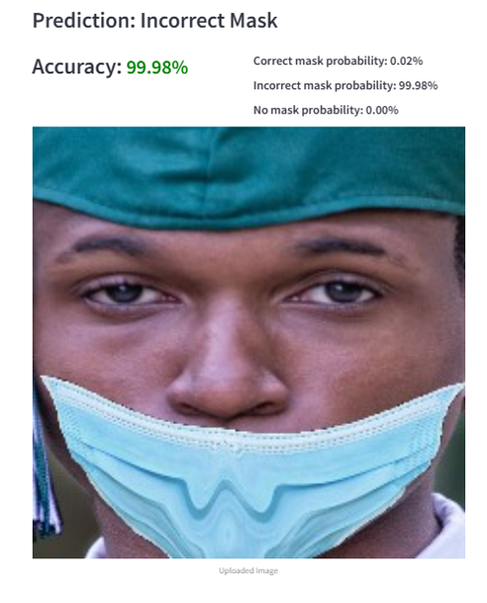

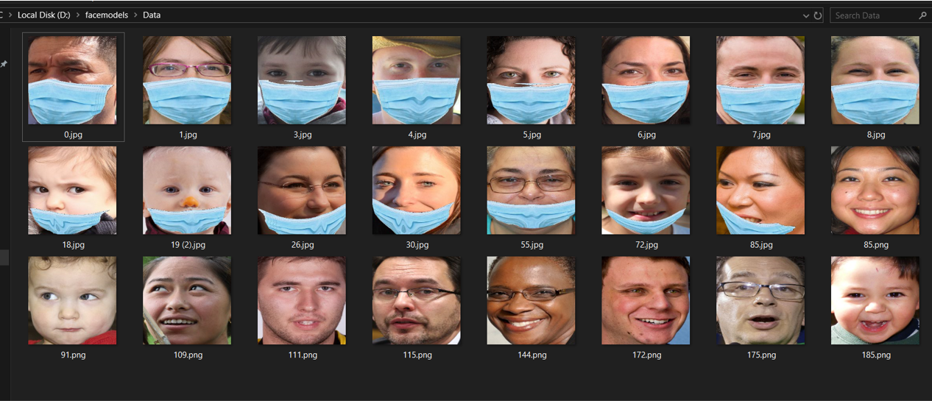
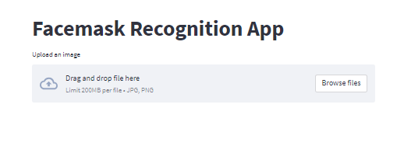
Deployment
Select an image
Select an image file from your computer. Supported file types are jpg, png, and jpeg.
Will display the predicted class
It will display the predicted class and probability of the image, along with an image preview
Open the web app
Open the web app in your web browser. The app should display a title and an upload button.

Slide 19

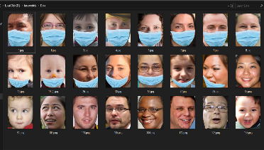
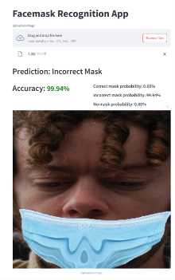
Deployment
How it works step by step staring by uploading an image
The user accesses the web app and sees a title “facemask Recognition App" and a prompt to upload an image.
The user selects an image from their local device by clicking on the "Upload an image" button.
The uploaded image is processed by the app using the process image function.
The processed image is then fed into the pre-trained TensorFlow model.
The predicted class and probability are displayed on the web app.
The uploaded image is also displayed on the web app for the user to see.
The user can then upload another image by clicking on the "Upload an image" button again and repeat the process.

Slide 20
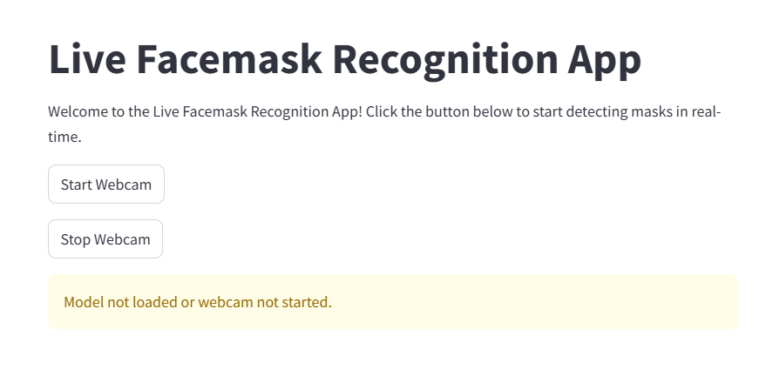
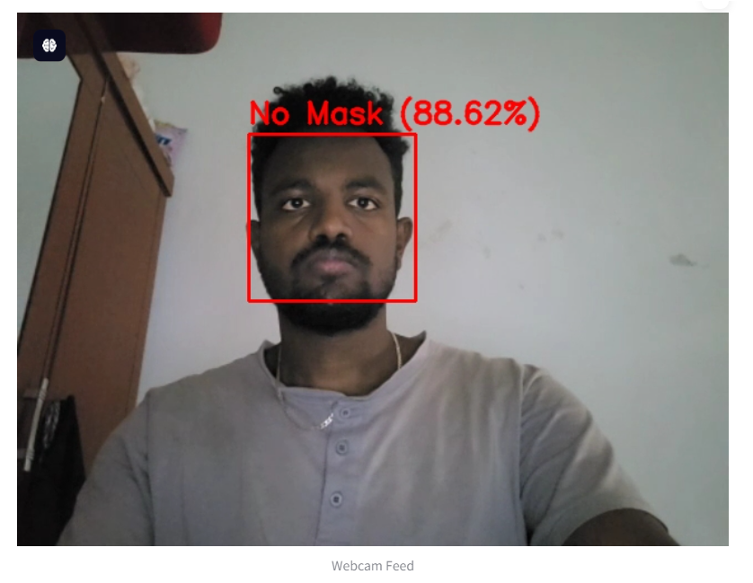

Slide 21
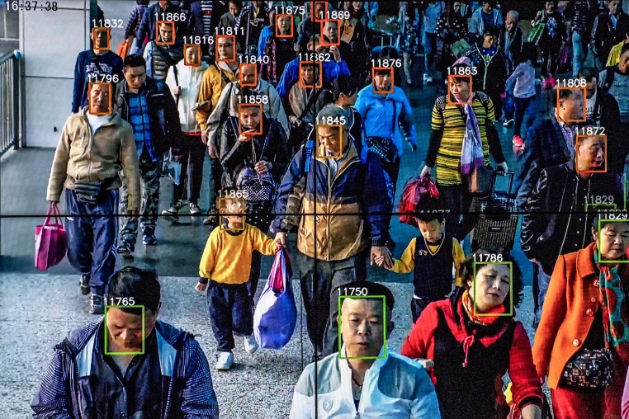
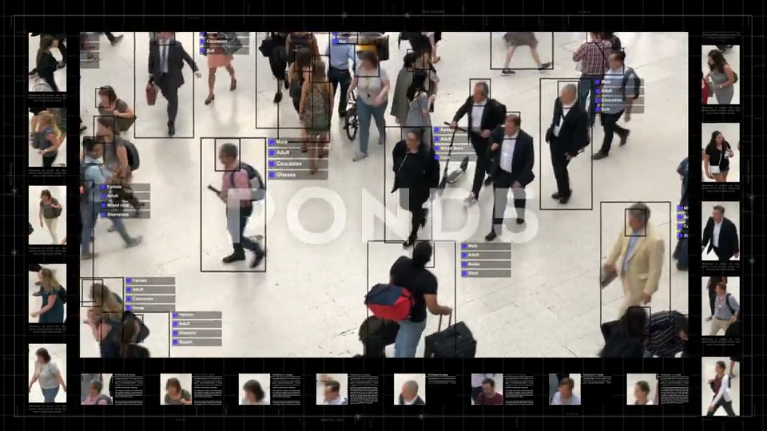
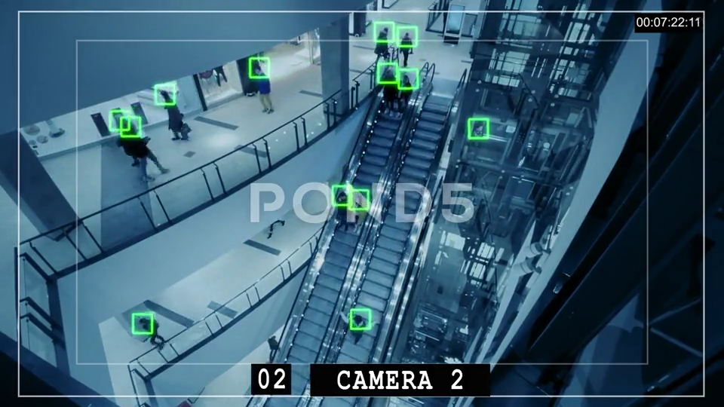
Applications
Public spaces:
Malls,
Airports,
Stations.
Corporate offices and factories.
Healthcare facilities and schools.
Conclusion
AI-based face mask detection promotes safety.
Automates monitoring with high accuracy.

Slide 22
LOGO
THANK YOU

